Slide 1
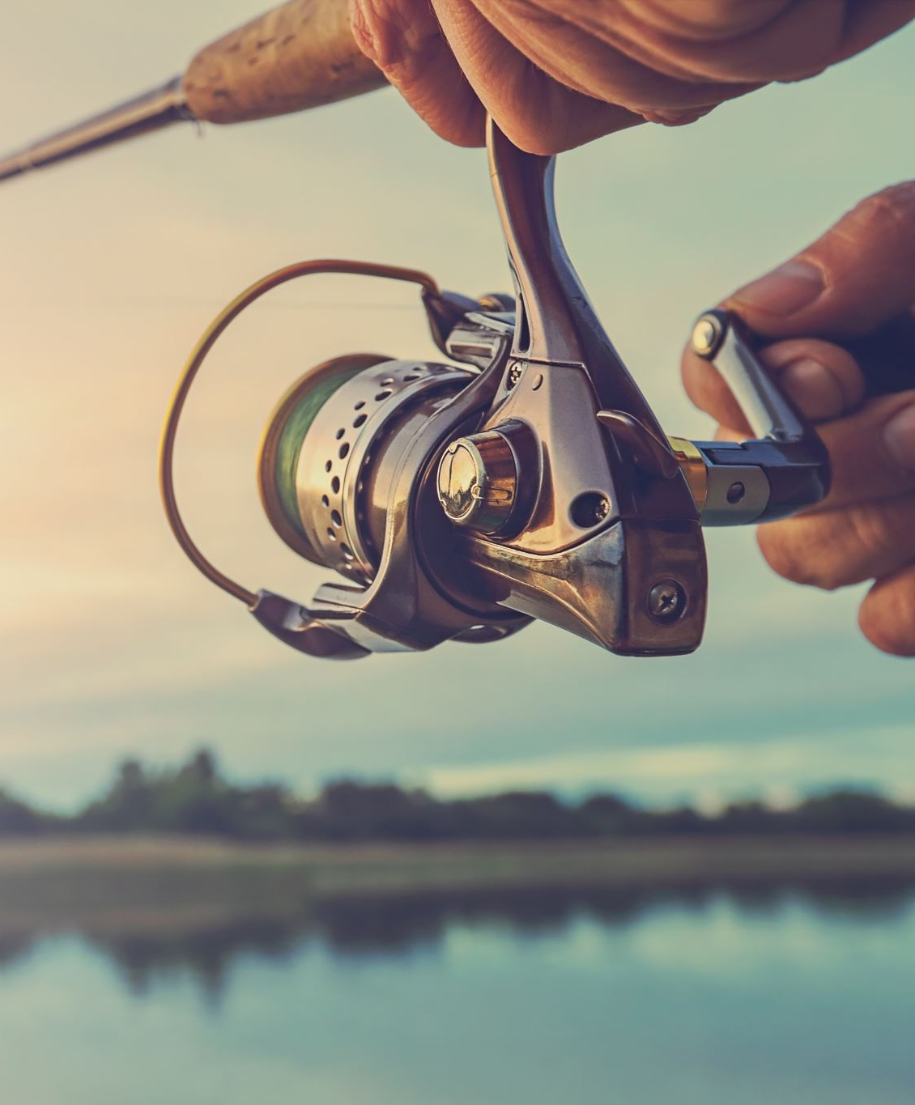
Wealthy Midwest Fishing
Created by Nicholas Wisnefske

Slide 2
What is Wealth Midwest Fishing’s Purpose?
WMF is a website that is meant to help new and experienced fishers from around the Midwest to connect and learn from each other to better improve fishing in the Midwest for everyone.

Slide 3
Marketing Objective
Wealthy Midwest Fishing uses a subscription model to allow fishers in the Midwest to purchase a package that fits their needs to best. Ever package has different amount of stuff included in them and the higher you go the more promotion you get to help others.

Slide 4
Target Audience
The target audience for WMF is anyone looking to start fishing or improve their fishing skills in the Midwest. WMF as well targets people that wish to help newer fishers learn new skills or find the equipment that helps them the most.

Slide 5
How does WMF intend to reach its audience?
WMF will work with Outdoors Midwest which is a magazine and new story site for everything Midwest to help promote to more experienced fishers about who we are. WMF will also be putting out google ads to help reach fishers that are just starting out or are looking to learn new things.

Slide 6
Wealthy Midwest Fishing Site
https://wisnefsken2894.stoutmartech.com/Index.php

Slide 7
Biggest Challenge
This year my biggest challenge was trying to understand some of the CSS terms like float, flex, margins, and padding. In my previous experiences with HTML and CSS I didn’t need to use these terms, so it took me a lot of time and practice to figure them out.

Slide 8
Biggest Success
My biggest success on this website was my button links that I had made for the equipment, current news, and subscription pages. Those buttons took me a lot of time to figure out but after figuring them out they became one of my favorite things on the site.

